Slide 1
MIMIC
A Critical Care Database
November 13, 2018
Jeff Box, John Giglio, Bill Magill, John Commander, Luke Williams

Slide 2
Agenda
Methodology (8 min)
Results (5 min)
Questions (2 min)

Slide 3
Methodology
End-to-end analytics paradigm:
Process efficiency
Error-reduction in analysis
Value-driven outcome.
The Ask
Data Source
Strategy & Metrics
WHY
Data Plan
Data Retrieval
Data Clean
HOW
Analyze
Limitations
Story-telling
WHAT

Slide 4
The Ask
Overview
The MIMIC-III (Medical Information Mart for Intensive Care) Clinical Database contains comprehensive clinical data from 40,000+ Intensive Care Unit (ICU) patients. This data is analyzed for predictive analysis and machine learning purposes.
Objectives
Classify patients as likely to die based on clinical information.
Predict length of stay (LOS) from patients likely to live.
Predict time to death from patients likely to die.
Business Case
Improving patient care and potentially saving lives
Prioritizing important clinical measures on patient admission
Understanding and optimizing patient throughput
Notes:
Obtained from https://mimic.physionet.org/ and requires granted permissions

Slide 5
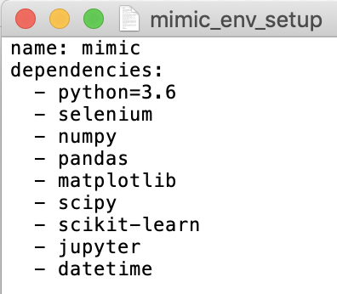
Source & Resources
Data: aggregated csv query from database, “…”
Tool: Python 3.6 “mimic” custom environment
Deliverables:
Jupyter Notebook containing ML solution
Visualization outputs for deeper understanding
Readme.md and presentation containint explanation and methodology

Slide 6
The Strategy
We are trying to classify mortality probability given a set of features
From there, we are trying to predict LOS and TTD depending on the classification with the same set of features
Therefore the strategy is: use a neural network and a multi-variate regression via a Supervised Learning (ML) model to classify and predict

Slide 7
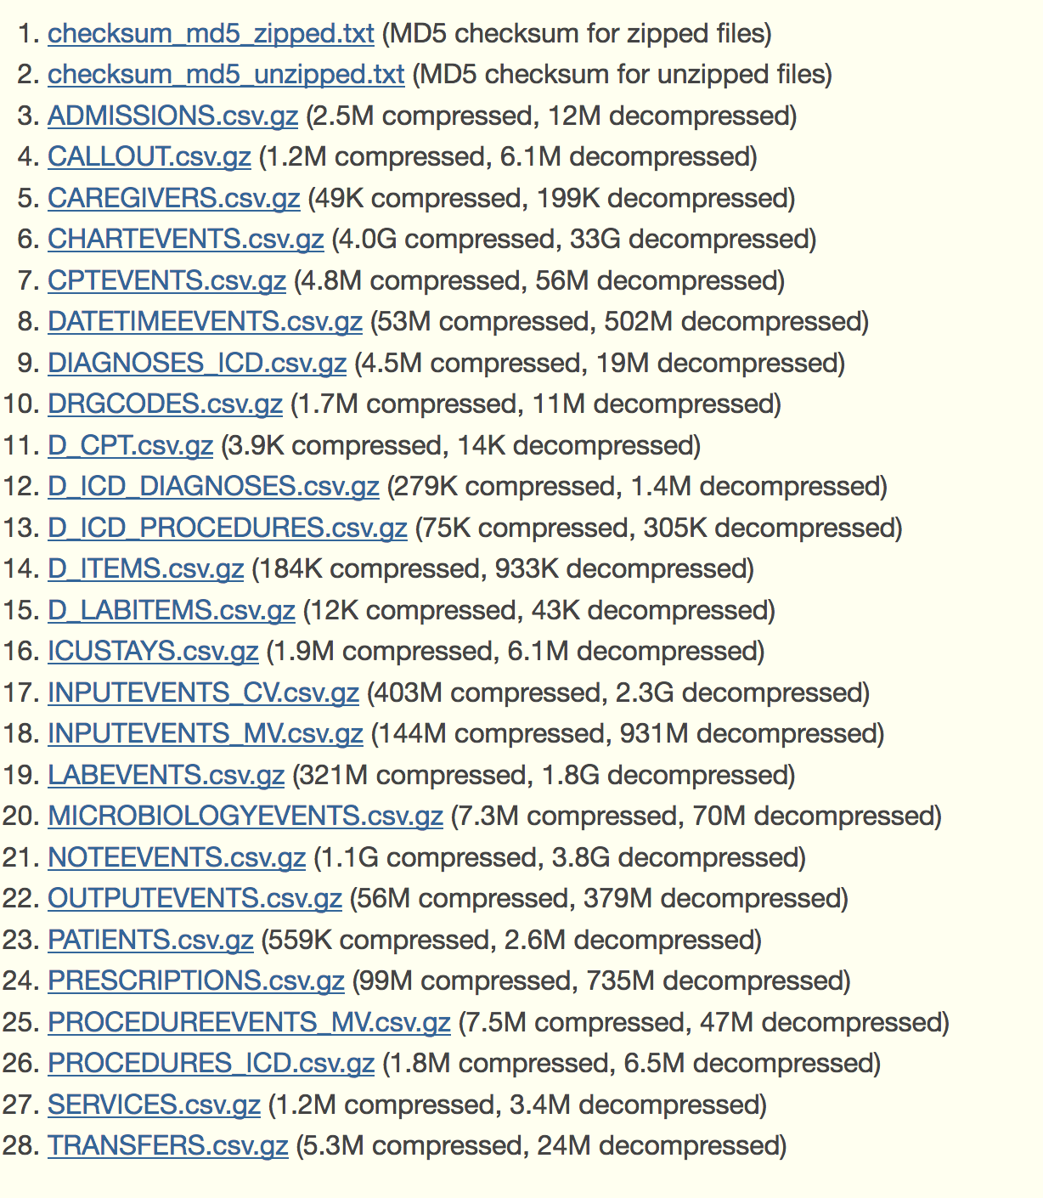
Data Planning & Retrieval
28 CSVs contained in a permission-only database
Mixed data types across CSVs
Multiple sets of information pertaining to each patient
Multiple patient admissions
Blinded time and demographic data
Notes:
General - Patient demographics, hospital admissions & discharge dates, room tracking, death dates (in or out of the hospital), ICD-9 codes, unique code for health care provider and type (RN, MD, RT, etc). All dates are surrogate dates because of privacy issues, but time intervals (even those between multiple admissions of the same patient) are preserved.
Physiological - Hourly vital sign metrics, SAPS, SOFA, ventilator settings, etc.
Medications - IV meds, provider order entry data, etc.
Lab Tests - Chemistry, hematology, ABGs, imaging, etc.
Fluid Balance - Intake (solutions, blood, etc) and output (urine, estimated blood loss, etc).
Notes & Reports - Discharge summary, nursing progress notes, etc; cardiac catheterization, ECG, radiology, and echo reports.

Slide 8
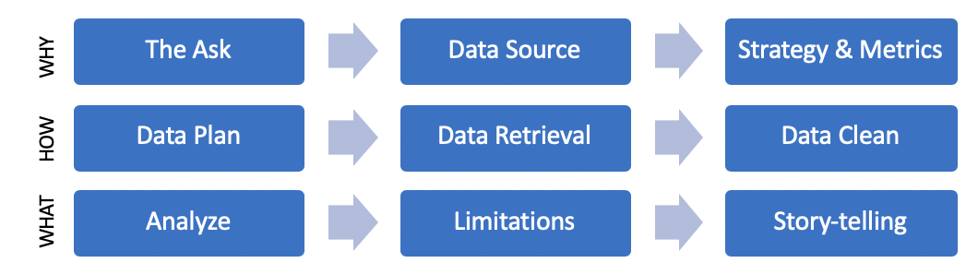
Data Cleaning & Aggregation
Re
REPLACE WITH CONCISE EXPLANATION / DIAGRAM

Slide 9
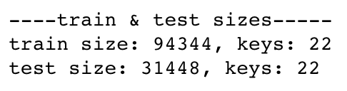
Data Transformation
Rename headers
Easier format, reduced coding error, and increased efficiency
Extract day, month, year from “DateStringYYYYMMDD”:
Know information about each and predict using each feature
Dummy data for qualitative features
ML in Python requires qualitative data to be in quantitative form
Assignment and reshaping of data
ML in Python requires a specific shape to match the method input
Create Train and Test datasets
Validate the model and prevent overfitting
Used default distribution: Train = 75%; Test = 25%
REPLACE WITH CONCISE EXPLANATION / DIAGRAM
X_train, X_test, y_train, y_test = train_test_split(data, target, random_state=42)

Slide 10
Analysis
TBD, but these are likely
Load
Prepare
Understand
Model
Train
Predict
Classifying patients as likely to live or die: Neural Net…?
We need a probability
Predicting LOS: SciKit-Learn’s RandomForestRegressor (RF)
Why? We want a robust, scalable classifier that returns a rank of feature importance.
RF gives a clean 'importance' output which answers our business questions
RF scales at production due to the way trees make decisions
RF applies to multivariate linear regression ML
Predicting TTD: SciKit-Learn’s RandomForestRegressor (RF)
Why? Same justification as above.

Slide 11
Limitations
Examples
The blinded data
Adding more features (with more time)_
Time series consideration
Covariance... How do these variables interact? Feature engineering
Cost analysis of fitting the RF model
Deeper understanding of outliers

Slide 12
Conclusion EXAMPLE
We can predict future sales using features contained in our dataset with an appropriate model evidenced by the residual plot and scoring (shown) →
The top 5 predictors of sales were obtained by ranking in RF’s Feature Importance method. Given the rule of 98%, we can safely include the first ~14 features.
Sales are predicted positive on 2017-07-15. Top five stores in terms of sales revenue are: 17, 2, 31, 20, and 38
REPLACE
Model Results:
MSE: 3564.29
R2: 0.623

Slide 13
Story EXAMPLE
Our inputs are strong importance features
in our RF model
Sales will be positive on 2017-07-15
Top five stores will be: 17, 2, 31, 20, and 38
REPLACE
Sales Revenue
overall avg = 118.20
Store ID

Slide 14
Questions?

